Slide 1

Project Phase 1 Presentation DESIGN AND IMPLEMENTATION OF BIONIC LIMB Presented by Aseem Mishra (T150953004) Samiksha Kamble (T150953058) Aditya Sangale (T150953059) Guided by Prof. Harshali Mane
Dept. of Electronics and Telecommunication
Hope Foundation’s
International Institute of Information Technology Hinjawadi Pune

Slide 2

Outline
Introduction
Literature survey
Gap Identification
Problem statement and Objectives
Proposed Methodology
Requirement analysis
Impact analysis
Professional Ethical practices to be followed
System Implementation
Results and discussion
Conclusions and Future Scope
References

Slide 3
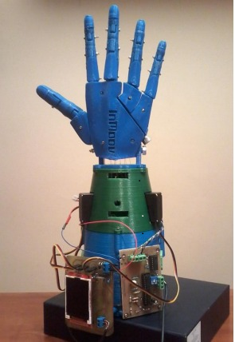
Introduction
1.Why are hands important ?
2.Survey On Hand Injuries
3.What is Prosthesis?

Slide 4

Literature survey
Year | Author | Title | Publishing Journal | Techniques Used | Conclusions
2016 | Chandra Mohan , Purushothaman | Design and Fabrication of Prosthetic Human Hand using EEG and Force Sensor with Arduino Microcontroller | International Journal of Engineering Science and Computing | Based on a simple, flexible and optimal control strategy that enables the person to use the device as normal arm. | The design and simulation for the prosthetic hand was completed in this paper
2015 | Arnau Capell Gràcia | DESIGN AND IMPLEMENTATION OF A BIONIC ARM | International Journal of Computer Applications | The prototype uses enclosure and impingement technique. | It has been thought to be used by anyone such as a prosthesis tester and it accomplish the expectations.

Slide 5
Literature survey
Year | Author | Title | Publishing Journal | Techniques Used | Conclusions
2021 | Yan Miao Mengda Xuab | Bionic Reconstruction after severe limb trauma and limb loss | Journal of Neurological Sciences | Interact with complex mechatronic devices in an intuitive and natural way | Demonstrates the viability of self-making prosthesis compared with the prices in market.

Slide 6
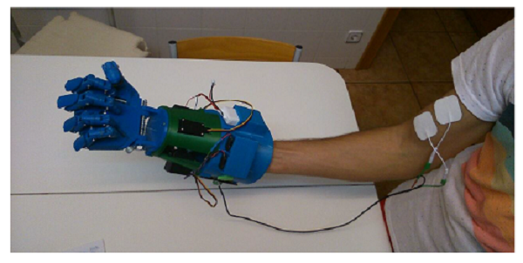
Gap Identification
High Cost
Weight
Rehabilitation

Slide 7
Problem statement and Objectives
1.Problem statement
The aim of this project is to create a prototype of a hand which can be placed on the forearm of the body.
2.Objectives
• The main objective is to design and develop a reliable low - cost prosthetic arm control circuit.
• A control system circuit using Arduino will be proposed.
• A Simulation of the proposed system will be run.
• Performance evaluation of the proposed system will be carried out.

Slide 8
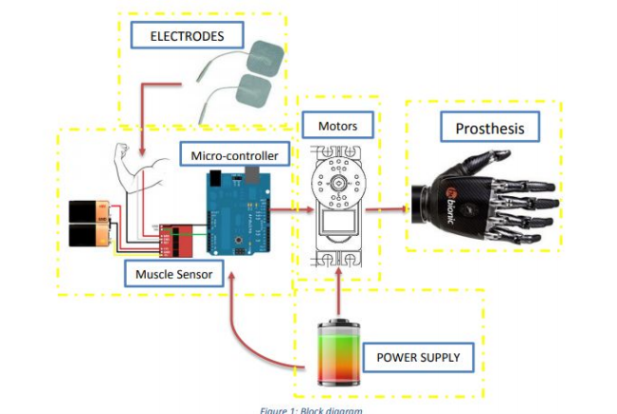
Proposed Methodology

Slide 9
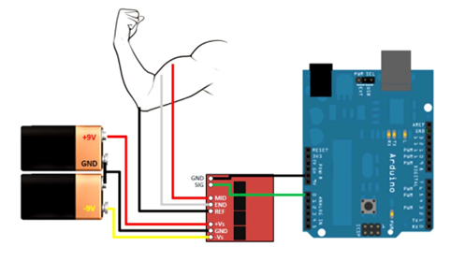
Proposed Methodology

Slide 10
Proposed Requirement analysis
Resources Required:
M2x20 Screws: 100
Allen bolts
Fishing line
Arduino UNO
Pack 16 electrodes
ABS or PLA- Printing Material
PCB boards & components -
9V battery (x2)
7.4V LIPO Battery
Push Buttons
Servo Motors and Wiring
LCD Screen: TFT ILI9225
INA125P- Amplifiers
Modern Engg. Tools:
3D Printer: Prusa i3
Designing Software: 3d Paint
Slicer software: Slic3r
PCB Designing: Proteus/Ki-Cad

Slide 11
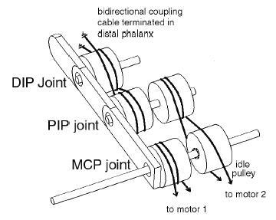
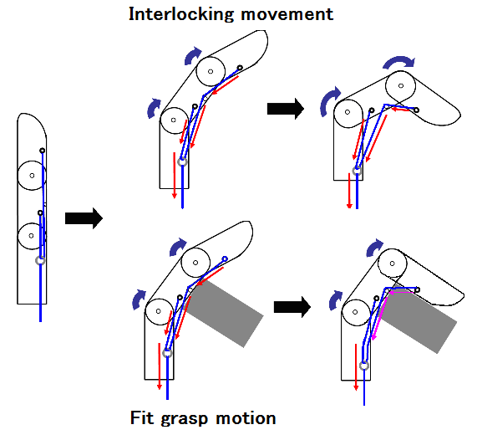
Proposed Requirement analysis

Slide 12
Impact analysis
Social:
Positive Impacts:
1. Limb Movement
2. Perform Various Activities
3. Physical Manipulation of things
4. Active Participation In social Activities
Negative Impacts:
1. May Experience Severe pain
2. Extra weight of limb
3. Uneasiness

Slide 13
Environmental:-
Positive Impacts:
1. Some bionics can even give you abilities that normal body parts can’t do.
2.Bionics help people who are disabled live a more normal life.
Negative Impacts:
1. E- waste & plastic pollution.

Slide 14
Professional Ethical practices to be followed
All the data and tools used in this project are free and open source.
All the circuits are self generated and not been taken from any other sources
The information used is downloaded from reliable sources and hence results are trustworthy .
Any kind of manipulation of data is not done to achieve desirable results
All the images used in this project are free and open source.

Slide 15
Expected Costs and Economic Aspects
TFT ILI9225 | 1000rs
Arduino UNO | 1500 rs
Pack 16 electrodes (4x4cm) | 800rs
Allen bolts | 120rs
Pack 100 screws M2x20 | 400rs
7.4V LIPO Battery 1200mAh | 900rs
PCB boards & components | 1200rs
9V battery (x2) | 800rs
Fishing line | 500rs
Total | 6750rs

Slide 16
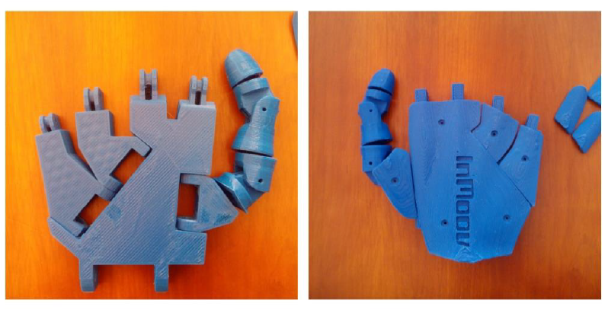
System Implementation
1] DEVELOPMENT OF THE PROTOTYPE
3D DESIGN
DESIGN OF A FOREARM PIECES
3D PRINTING
ASSEMBLY OF THE PROTOTYPE
2] SCHEMATIC DIAGRAM
CIRCUIT DIAGRAM OF A MUSCLE SENSOR
PCB DESIGN OF A MUSCLE SENSOR
3] ARDUINO SHIELD
CIRCUIT DIAGRAM OF ARDUINO SHIELD
PCB DESIGN OF A ARDUINO SHIELD
4] ARDUINO CODE
5] OUTPUT

Slide 17
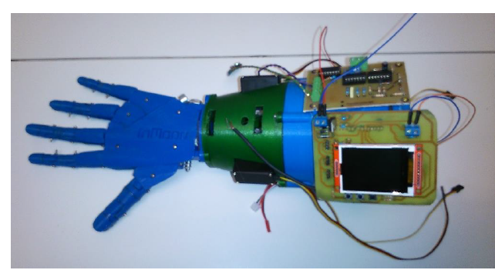
ASSEMBLY OF THE PROTOTYPE

Slide 18
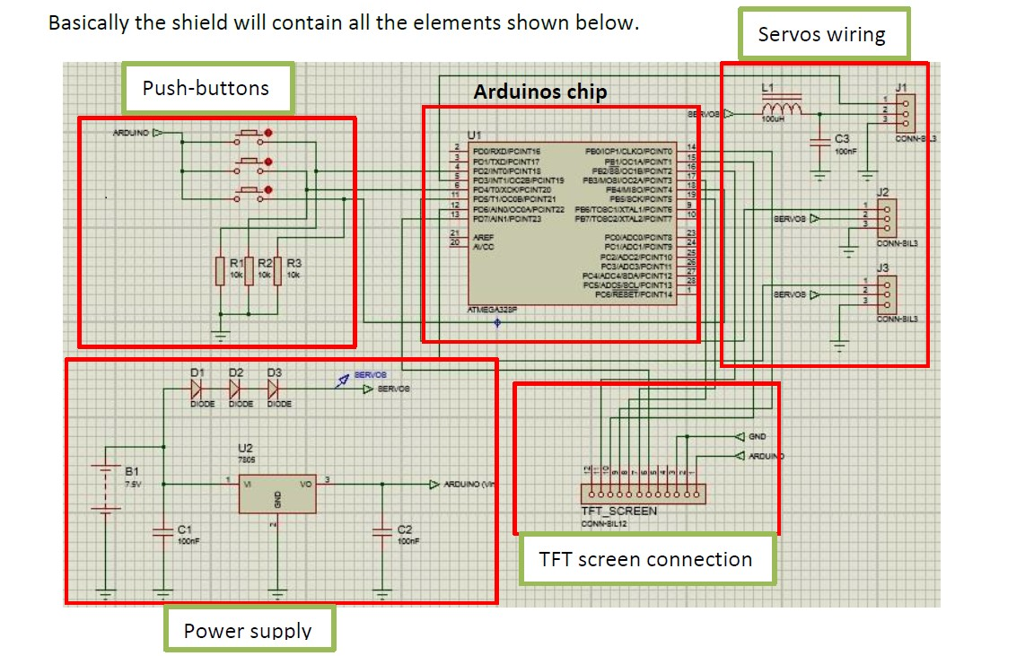
CIRCUIT DESIGN

Slide 19
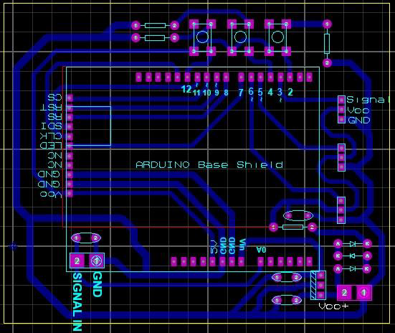
PCB DESIGN

Slide 20
Results and discussion
Needed to evaluate the output.
Preferable to obtain a signal really smooth in order to make the servos work properly later.
Tested the values of the signal with different forces.
Connect the Arduino and make a simple test with the servomotors.

Slide 21
Conclusions and Future Scope
Conclusions:
The prosthetic hand through additive manufacturing process is the ultimate solution for a cost effective prosthetic hand.
Increase in quality & accuracy of the model is achieved.
a unique combination of medical science and computer aid designing and manufacturing
Future Scope:
Automation
Continuous improvements of the program and the signal reading.
Improve the design to achieve more natural and real shape

Slide 22
References
Arduino. (2013). At Taller Arduino. Retrieved May 9th 2015 from: http://tallerarduino.com/tag/shield/
Arduino (2015). At Arduino Home. Retrieved May 15th from: http://store.arduino.cc/index.php?main_page=product_info&cPath=11&products_id=195
Camacho-Conchucos, H.T. (2010). Patients amputated by work accidents: characteristics and years accumulated of potential productive life lost. Retrieved March 4th, 2015 from: http://www.scielo.org.pe/pdf/afm/v71n4/a11v71n4.pdf
Fishing line (2015). At Decathlon. Retrieved May 10th 2015 from: http://www.decathlon.es/fully-300-m-id_8240217.html
Dorador González, J.M. (2004). ROBÓTICA Y PRÓTESIS INTELIGENTES. Retrieved March 15th 2015 from: http://www.revista.unam.mx/vol.6/num1/art01/art01-2d.htm
Electronics. (2015). At Wikipedia. Retrieved May 9th 2015 from: http://en.wikipedia.org/wiki/Pulse-width_modulation

Slide 23

References
Electronica. (2012). At Ravc_cs. Retrieved May 10th 2015 from: http://ravc00cs.blogspot.com.es/2012/07/pwm.html
Electronics. (2015). At Electronics Tutorials. Retrieved May 15th 2015 from: http://www.electronics-tutorials.ws/opamp/opamp_5.html
Electronics (2013). At Advancer technologies. Retrieved February 17th 2015 from: http://www.advancertechnologies.com/p/muscle-sensor-v3.html
Instrumentation amplifier (2015). At Texas Instruments. Retrieved May 19th 2015 from: http://www.ti.com/lit/ds/symlink/ina125.pdf
López Sullaez, L.C., and Estrada Ruiz, R (2009). Impact Occupational of Traumatic Amputation in Fingers of the Hand by Work Accident. Retrieved March 6th, 2015 from: http://scielo.isciii.es/pdf/mesetra/v55n217/original4.pdf
Operational amplifiers (2015). At Texas Instruments. Retrieved May 19th 2015 from: http://www.ti.com/lit/ds/slos081h/slos081h.pdf
Prusa Mendel. (2015). At RepRapWiki. Retrieved May 10th 2015 from: http://reprap.org/wiki/Prusa_i3

